Slide 1

KPBSD Native Education
3/6/2017

Slide 2
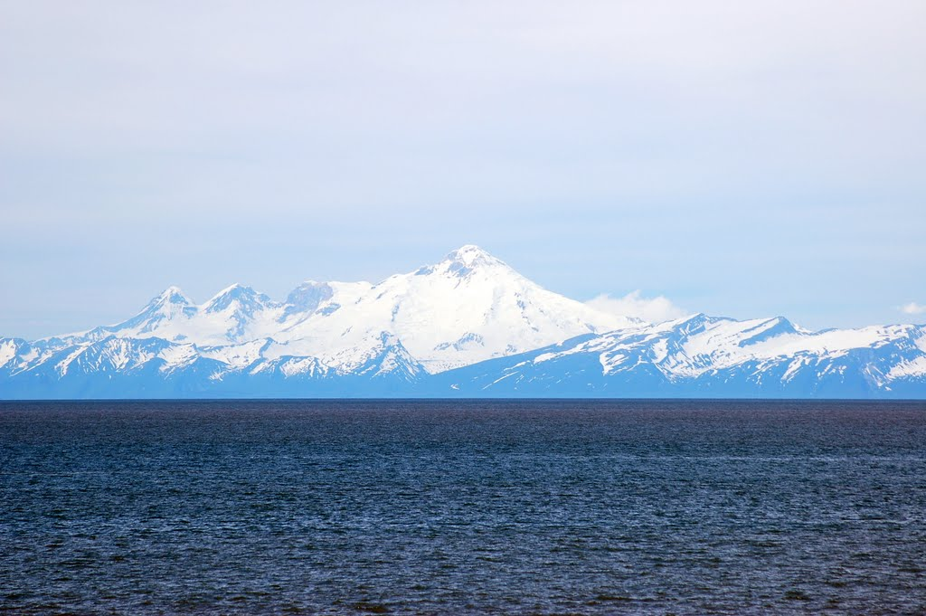
KPBSD Native Education Program
  Purpose: The purpose of the KPBSD Title VI Advisory Committee is to provide supplemental supports for Alaska Native and American Indian students for a successful experience throughout K-12 schooling years through prioritizing targeted assistance.

Slide 3
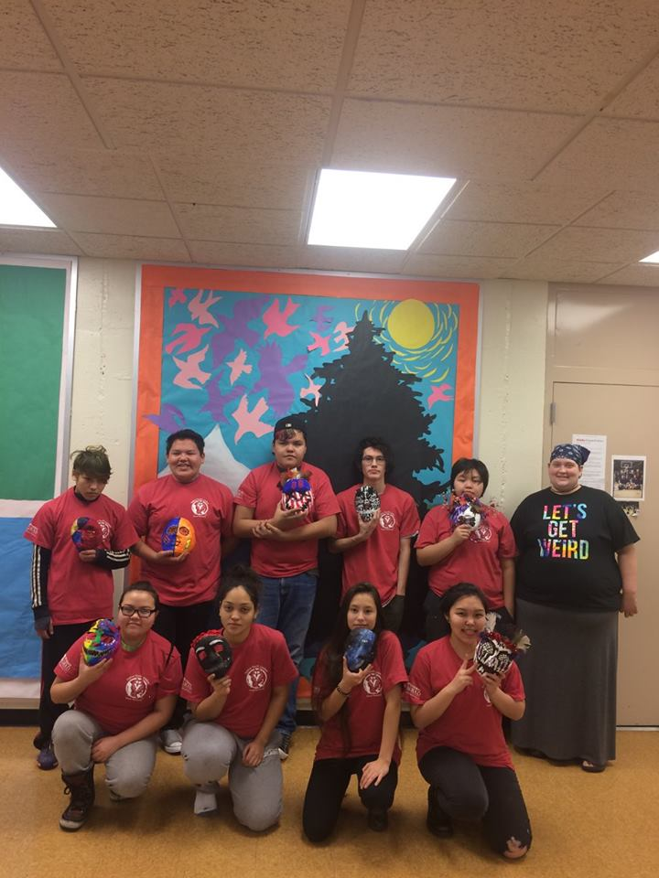
KPBSD Demographics
Over 114 Alaska Native Tribal affiliations represented in the nearly 1200 identified Native students
There are 20 different Native languages in Alaska (two main ones on the Kenai-Dena’iana and Sugcestun/Sug’sten)

Slide 4
KPBSD Title VI Advisory Committee
The KPBSD Native Education Advisory Committee, made up of parents, youth, and KPBSD staff, meets quarterly and provides input regarding the priority of services offered to qualifying Native students. The committee reviews program activities and reviews where targeted assistance is needed when setting priorities. Before 2015, Title VI programs were directly implemented by the KPBSD director of federal programs. In SY16, the District created a KPBSD Native Education Program Coordinator position. The new coordinator went to work with the existing KPBSD Title VI advisory committee to sub-regionalize its representatives and make updates to its by-laws. By-laws can be found on the KPBSD Title VI webpage.

Slide 5
Current KPBSD Title VI Advisory Committee Members
Parent Representatives |  | Student Representatives
Seat A—Region 1 (Tyonek, Nikiski, Kenai) | Elizabeth Standifer | Seat G—At-large | Nadia Walluk
Seat B—Region 2 (Sterling, Soldotna) | Michael Bernard Chair | Seat H—At-large | John Holland
Seat C—Region 3 (Seward, Moose Pass, Cooper Landing, Hope) | Rebecca Dixon | Staff Representative
Seat D—Region 4 (Ninilchik, Anchor Point, Homer) | Carolyn Choate | Seat I—At-large | Krystalynn Scott Vice Chair
Seat E—Region 5 (Seldovia, Nanwalek, Port Graham) | Vladimir Moonin
Seat F—At-large (any region) | Monica Anderson

Slide 6
Current Funding
The KPBSD Native Education Program is funded by the Federal Government’s Office of Indian Education, which is part of the U.S. Department of Education. Annual funding of the Native Education is based on the number of individual qualifying students enrolled in KPBSD. The KPBSD serves nearly 1200 Native students, and represents over 114 tribal entities in Alaska alone. Student eligibility for Title VI support is determined solely on the submission of a Title VI Indian Education OE506 form, found on the district ‘s Title VI Indian Education page, and also in the main office of any KPBSD school.
Current Funding: $476,000

Slide 7
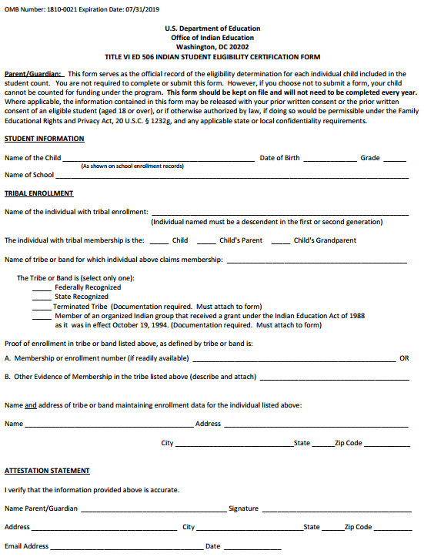
How we identify
OE506 Form Sent is required for any student to be qualified for Title VI programming. This form is found at each school office, as well as the KPBSD Title VI webpage. Parents or guardian must sign.
Enrollment demographics need to indicate ‘Alaska Native/American Indian’ or ‘two or more races’ when Title VI paperwork is completed.
Principals and secretaries have been encouraged to include this paperwork in all of their enrollment packets for incoming students.
KPBSD partners, including Kenaitze and Project GRAD also help KPBSD identify qualifying students.
Completed OE506 forms only need to be completed in a given district one time.

Slide 8
Priorities and Allocations
Due to limited budgeting, priorities are set to target students of greatest need. Academic targets for younger students have been limited because of the number of academic systems the district has in place to target all students of need.
Priorities for Title VI programming are assisted by the KPBSD Title VI Advisory Committee
Currently, the three main areas of focus are:
  Academic supports through tutoring at various MS/K-12 sites
  Partnership with Project GRAD and Kenai Peninsula Native Youth Leaders
  The Alaska Native Science and Engineering Program
  Other areas of recent support have been:
  Construction academies in Seldovia and with Kenaitze
  Support for students attending summer ANSEP Stem Career Exploration

Slide 9
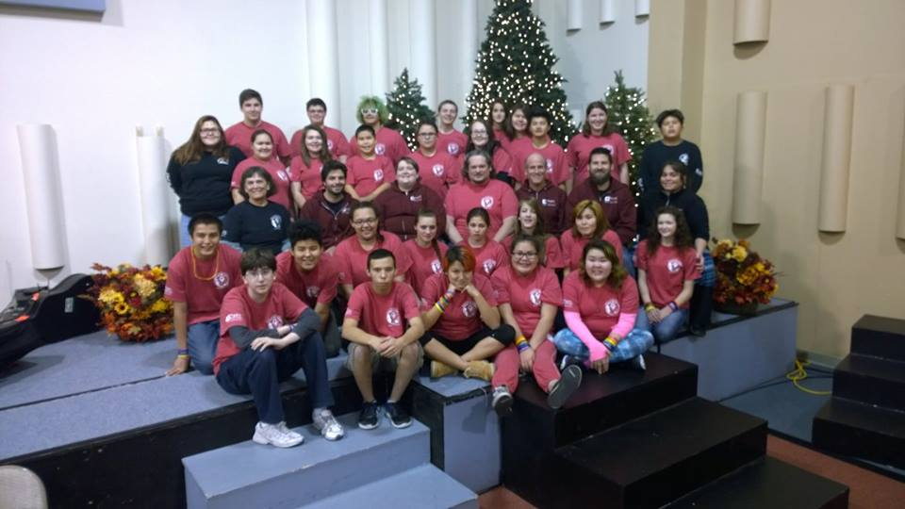
Project Grad and KPNYL
KPNYL
  Seldovia 7-12
  Homer HS
  Soldotna HS
  Soldotna Prep
  Skyview 7-8
  Kenai HS
  Kenai Alternative 7-12
  Nikiski 7-12
  Seward HS
  Nanwalek 7-12
  Port Graham 7-12
  Ninilchik 7-12
  Tyonek 7-12

Slide 10
ANSEP
In our 3rd year of participation
  FY15=48 students
  FY16=18 students
  FY17=11 students
  Middle School Academy is a two-week experience designed to promote science, technology, engineering, and math (STEM) education and careers. During this academic and residential academy, students engage in a variety of hands-on activities from building a computer, dissecting squid to testing structures on an earthquake simulation table and much more. Accepted students attend the academy free of charge.

Slide 11
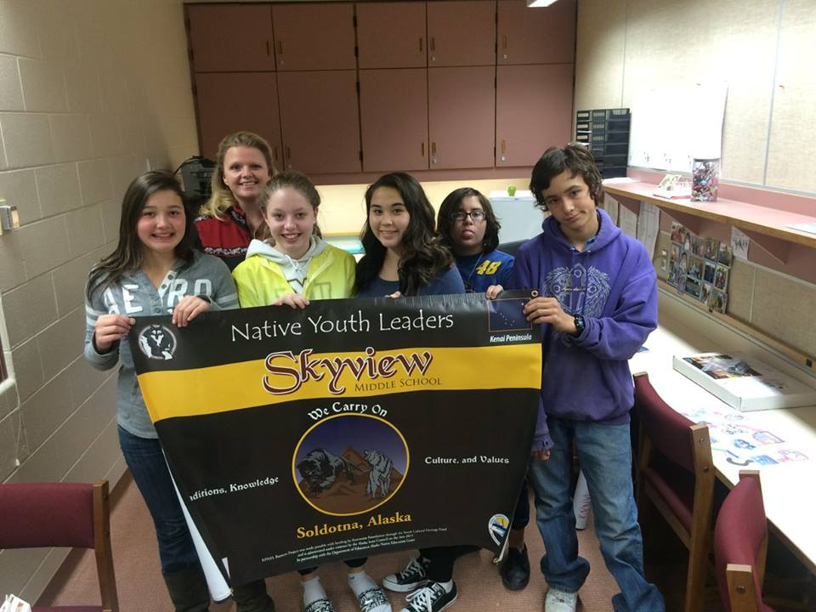
KPBSD Stats
FY16
Overall KPBSD Grad Rate-82.73%
Native KPBSD Grad Rate-80.43%
National Overall Grad Rate-80%
National Native Grad Rate-67%

Slide 12
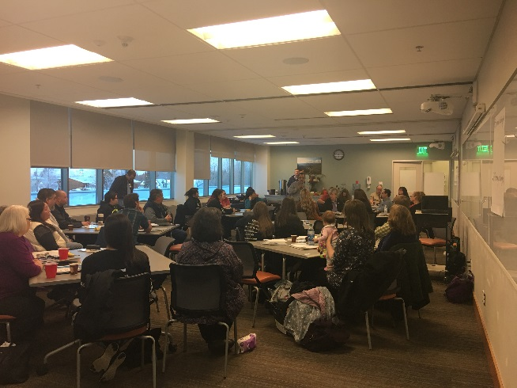
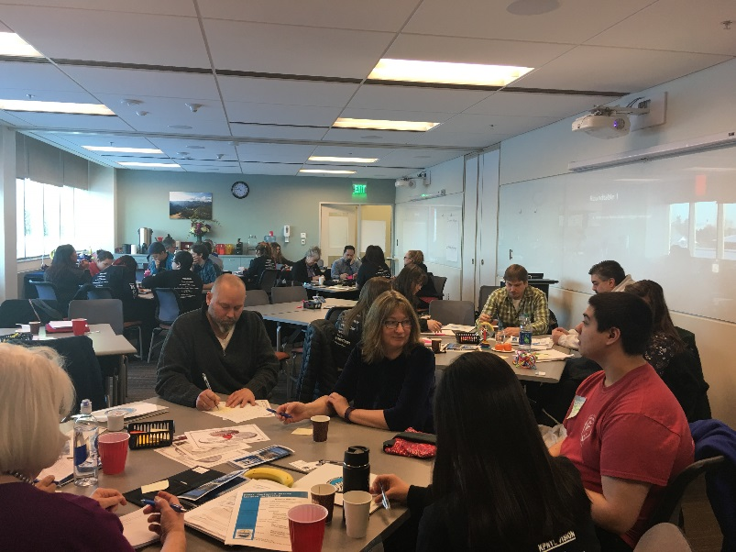
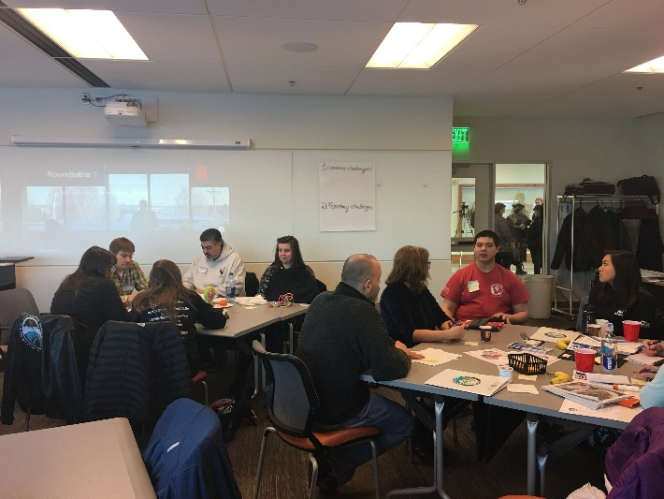
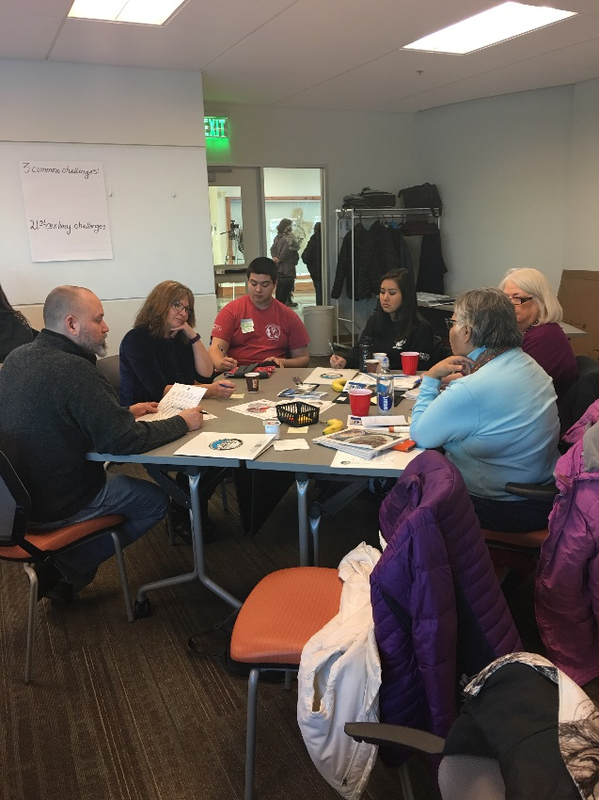
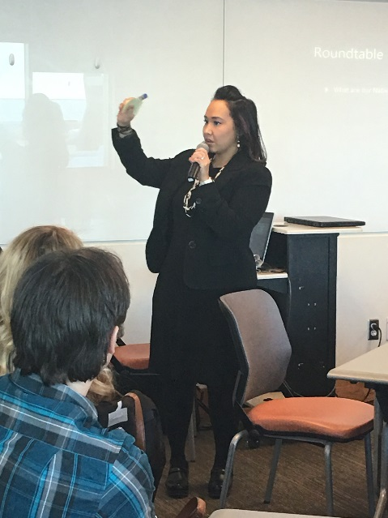
Native Leaders Gathering

Slide 13
Needs Assessment Results
https://www.surveymonkey.com/analyze/LL7yaaIl5vRIgVxfrBN3MS42rix4afGoFspz5i0JiLM_3D

